Slide 1

Frame Work
BY

Slide 2
AGENDA
Overall Develop Process
Data Usage
Method
Measure

Slide 3
Overall Develop Process
In-Sample Data, Re-Improve with potential
Out-of-Sample Data, Backtest and Update Assumption
Live Out-of-Sample Data
More Research
Method
Market
Money
Early Criteria
Measure
Monitor
Final Criteria
Monitor (Live Trade)
Fully Invest
Pass
Fail
Fail

Slide 4
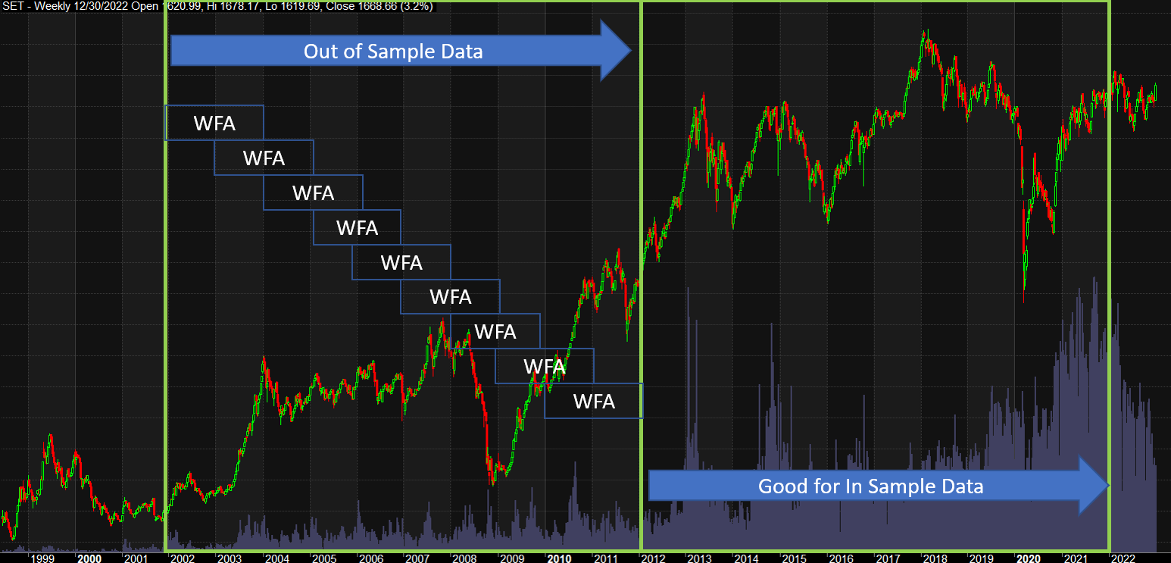
Data Usage

Slide 5

Method : Step 1
Basic Test
Preliminary Test
Monte Carlo 50 runs
4 Years
10% missing trades and 5-10% slippage
Position Score Effective Test (Random VS Condition)
Sensitivity Combination Test
- Checking whether a signal condition is important or not.
- Studying signal conditions' impact to enhance outcomes.
- Enhancing outcome solely with signal conditions.
Position Score Test
Strategy Evaluation
- Evaluating effectiveness of position score and determining optimal solution.

Slide 6

Method : Step 2
Sensitivity Analysis
Assessing impact of missing trades and slippage on our outcomes.
Monte Carlo 200 runs, 4 Years
Missing trades 10%, 20%, 30% VS Slippage 5%, 10%, 15%
Stop loss 10%, 20% and stop trailing 20%, 25%
Theory Check and Result Evaluation

Slide 7

Method : Step 3
Monkey Test
Comparing between our outcome and monkey test.
Monte Carlo 200 runs, 4 Years
Fix Slippage, Stop Loss, and Trailing Stop
Random Entry/Exit, Signal, and missing trades
Try to get the number of trades closed to those in standard trade modeling.
Early Criteria

Slide 8

Measure
Out-of-Sample Preliminary Test
Out of sample Test
Monte Carlo 100 runs
4 + 4 Years
10% missing trades and 5-10% slippage
- To prevent curve fitting.
Sensitivity Analysis
- Assessing impact of missing trades and slippage on our outcomes.
Theory Check
Min & Max Initial Equity negative impact Test
Sensitivity Analysis
- Verifying initial equity's minimum and maximum.
Monte Carlo 2000 runs, 4 + 4 Years
1. Missing trades 10%, 20%, 30% and Stop trailing 20%, 25%
2. Stop loss 10%, 15%, 20% and stop trailing 20%, 25%
Theory Check

Slide 9
Measure
Monte Carlo WFA - Trade Modeling
Monte Carlo 300 runs, 2 Years 6 Month walks
Monte Carlo WFA
Perform at least 300 simulation runs for each OOS Period
Verifying significant outcomes for subsequent comprehensive analysis: sensitivity analysis, CDF, etc.
Ensuring efficiency of the backtest result.
Final Criteria
Final Out-of-Sample Strategy

Slide 10

Thank You

